Slide 1
Youth Reinvestment Grant Program Statewide Evaluation | Round 2 Grantees
Overview of Evaluation & Quarterly Progress Report
October 6, 2020

Slide 2
Statewide Technical Assistance Team
Institute for Social Research at Sacramento State University
Project Team
Shannon Williams
Jessica Newham
James Vergara
Statewide Evaluation TA Email: YRGEval@csus.edu

Slide 3
Overview
Purpose of Statewide Evaluation
Statewide Evaluation Process
Quarterly Progress Report Form
Technical Assistance

Slide 4
Purpose of Statewide Evaluation
Describes implementation and outcomes
Based upon proposed project activities and expected outcomes
Research design must rely on aggregate data exclusively
Notes:
The RFP outlined the purpose and the parameters of the statewide evaluation.

Slide 5
Developing the Statewide Evaluation Plan
Reviewed all Round 1 grantee proposals
Identified areas of alignment
Developed Statewide Logic Model
Developed Quarterly Progress Report (“QPR”)
Produced semi-annual Grantee Dashboards

Slide 6
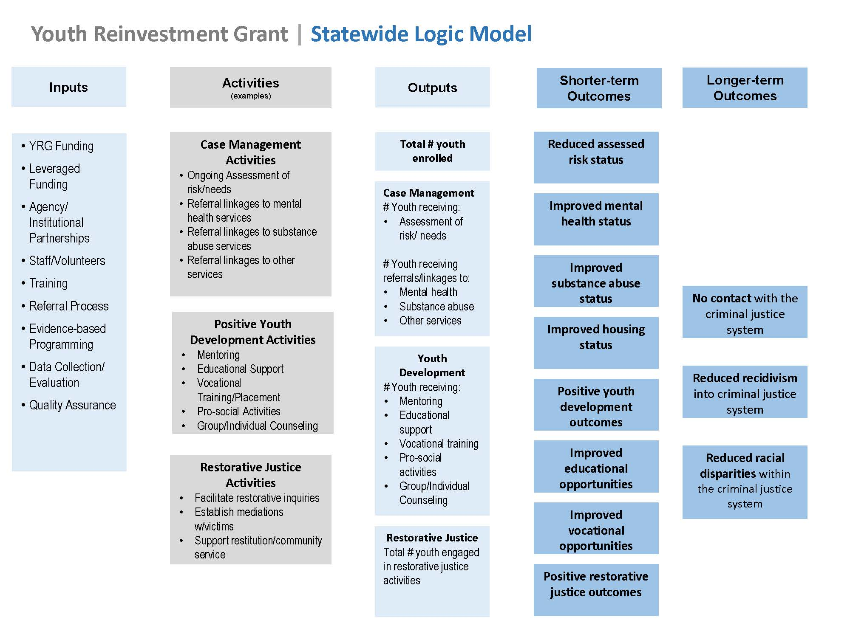

Slide 7
Quarterly Progress Report
Collects quarterly updates on grant spending and overall progress (for BSCC)
Collects quarterly project and evaluation data
Project Inputs & Implementation
Status of Grant Agreement Goals & Objectives
Description of Grantee Project
Youth Participant Reporting
Youth Participating in Activities
Successfully Exiting Youth Outcomes
Q1&Q2 QPR due February 15th

Slide 8
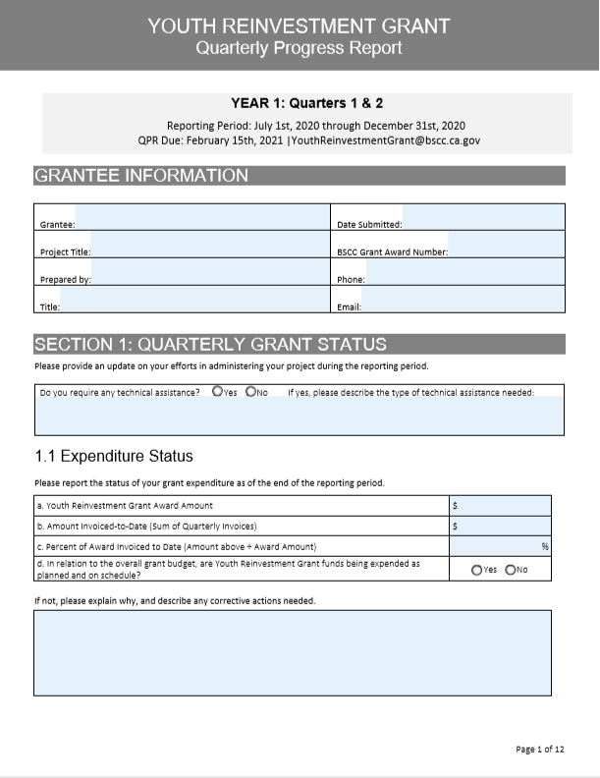
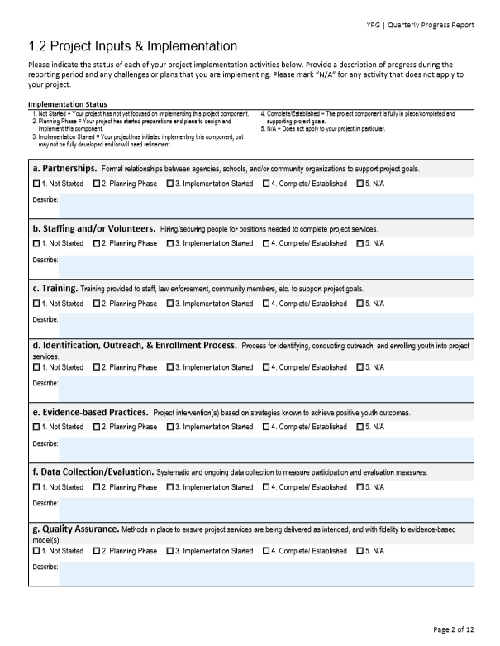
Dashboards created with QPR data

Slide 9
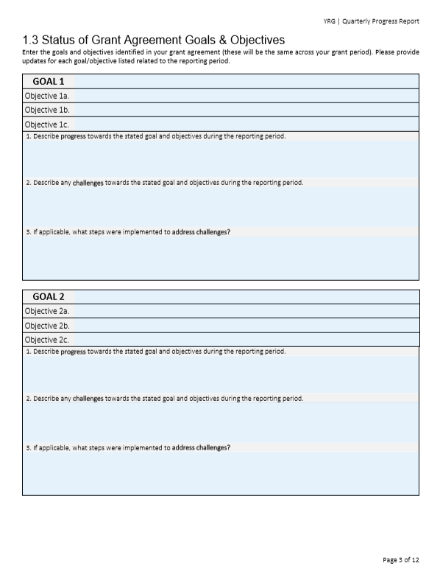
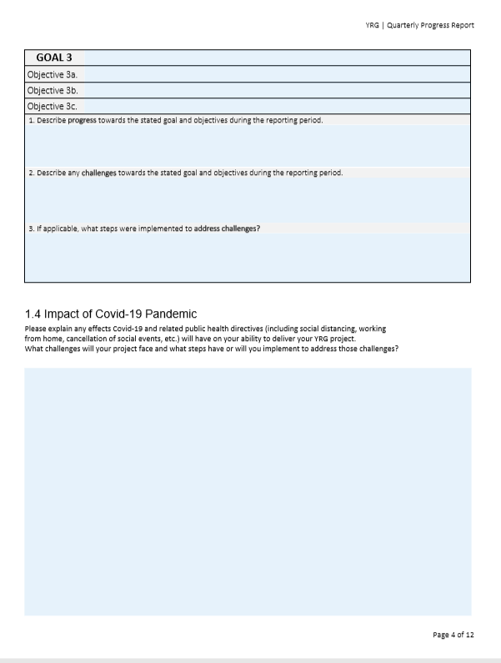
Dashboards created with QPR data

Slide 10
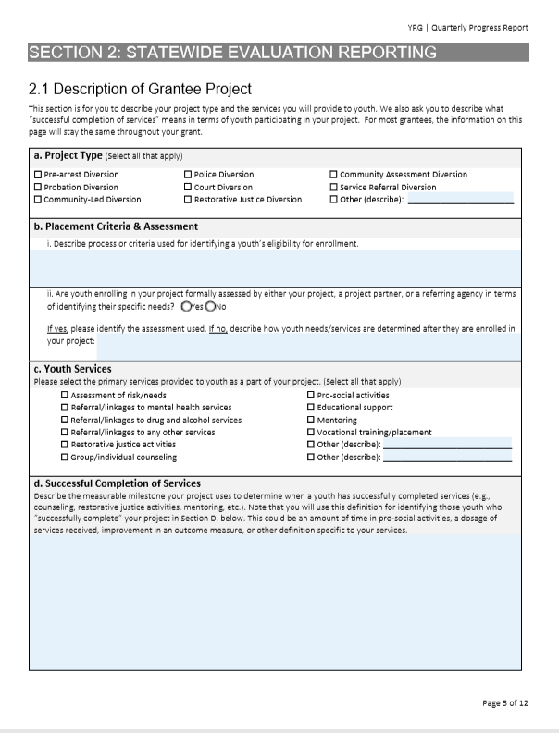
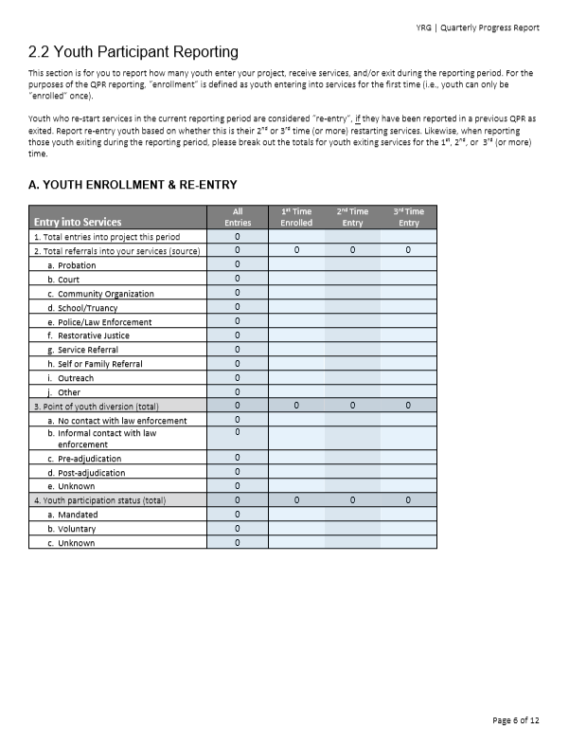
Dashboards created with QPR data

Slide 11
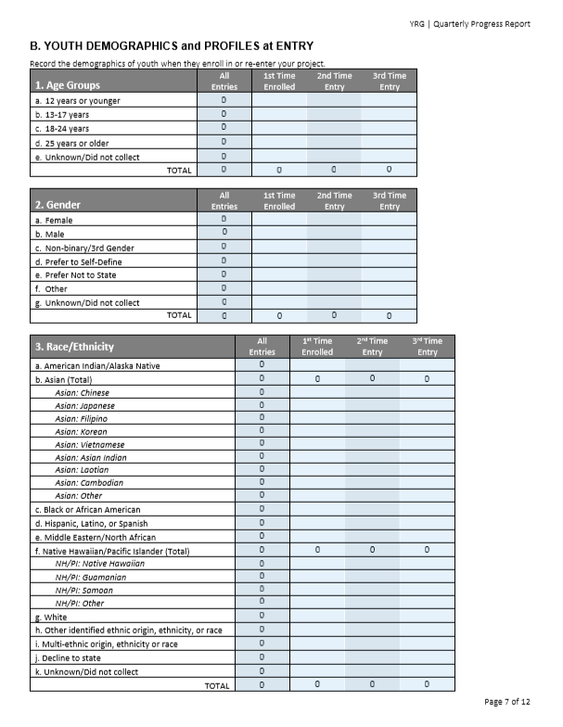
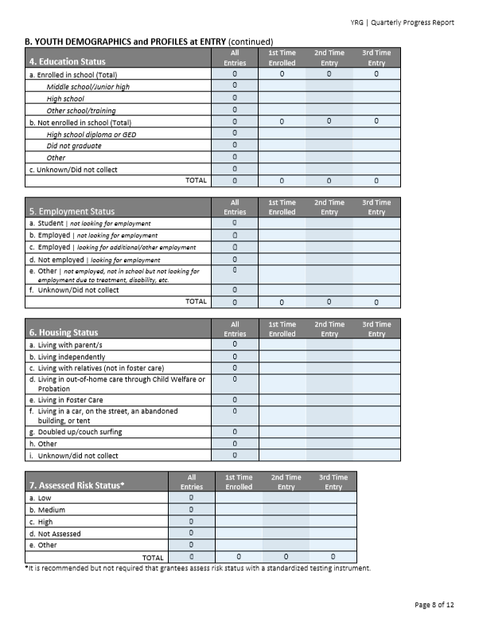
Dashboards created with QPR data

Slide 12
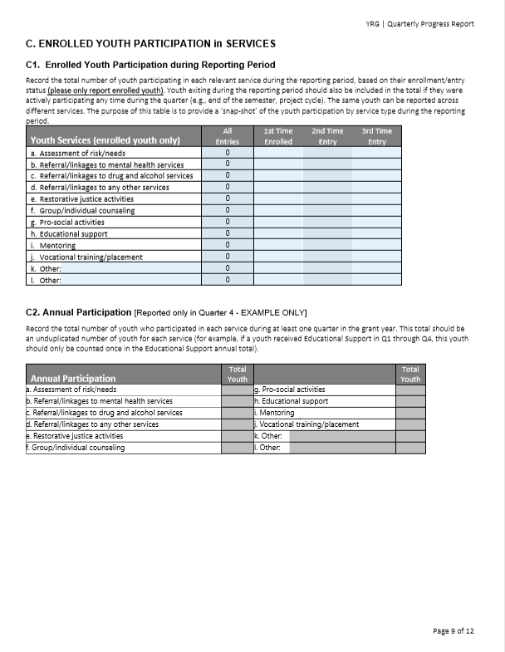
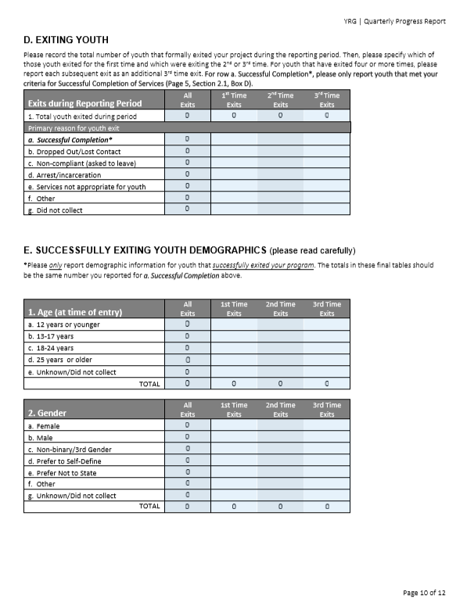
Dashboards created with QPR data

Slide 13
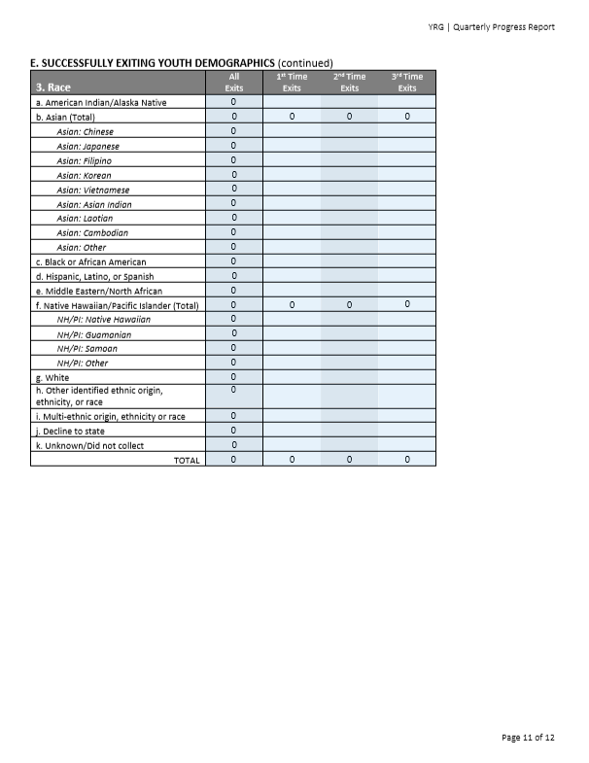
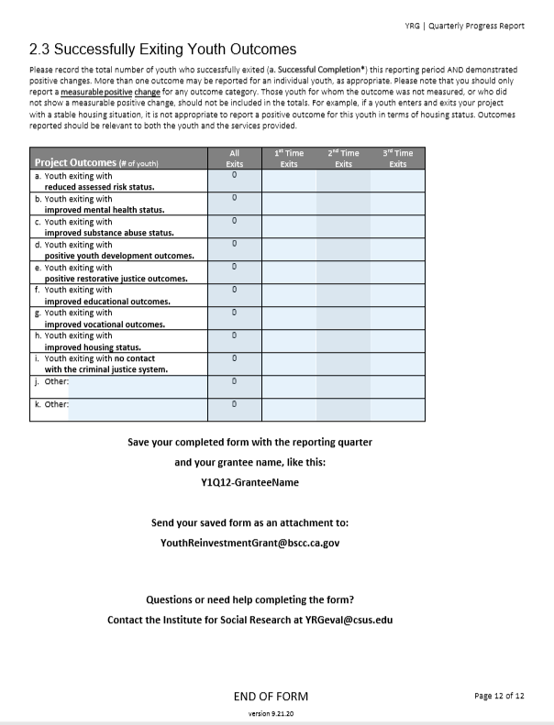
Dashboards created with QPR data

Slide 14
Grantee Technical Assistance
Instructional Guide for Completing the QPR
Email YRGEval@csus.edu to get in touch with our team
Technical assistance webinar on January 20th to walk through QPR and answer any questions

Slide 15
Dashboards created with QPR data
ISR prepares bi-annual Dashboards with grantee and statewide data
You will receive a Dashboard with your project data, and a YRG Statewide Dashboard
Dashboard example:

Slide 16
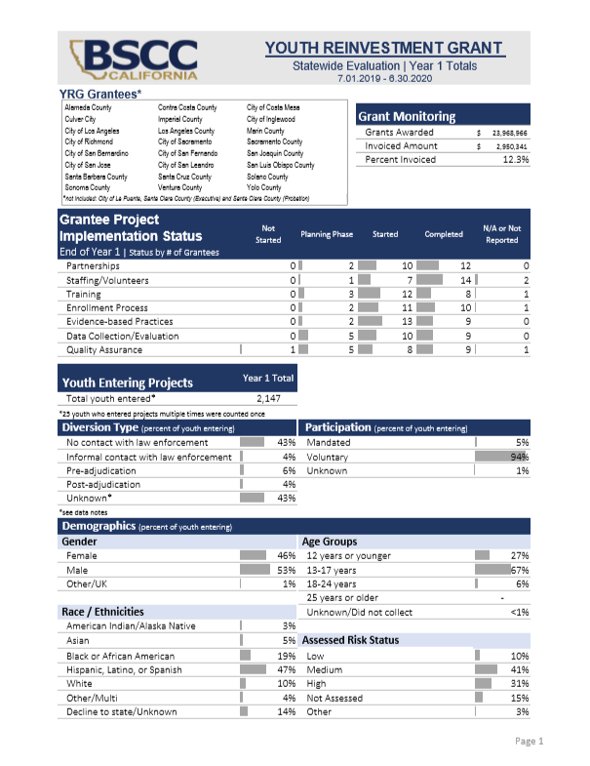
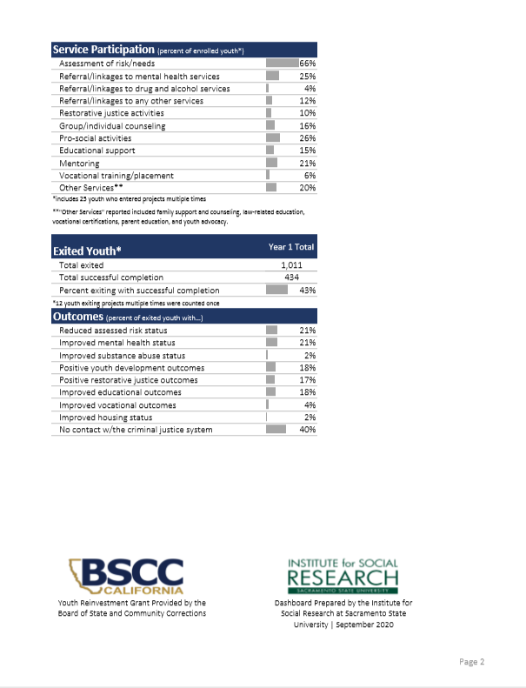

Slide 17
Questions?

