Slide 1
Use of Force and De-escalation Training Pilot Program
Reporting Requirements Webinar
Date: May 17, 2023
Start Time: 1:00PM

Slide 2
Agenda
Introductions
Program Background
Program Description
Program Reporting Requirements
Program Reports
Questions

Slide 3
INTRODUCTIONS

Slide 4
Program Background
2022 Budget Act (Assembly Bill 178, Chapter 45, Statutes of 2022) established the Use of Force and De-escalation Training (UFDT) Pilot Program
$9,700,000 in funding over three years to six agencies
UFDT Data Reporting Guide Page 1

Slide 5
Program Description
Use of force and de-escalation training approved by the Commission on Peace Officers Standards and Training (POST)
No more than 10 percent of the grant funding used for staffing hours, including overtime and backfills
UFDT Data Reporting Guide Page 1

Slide 6
Program Reporting Requirements
Number of participants who received training
Demographic data that includes race, gender, and position
Names and description of trainings selected and used
Use of force incidents data in the three previous calendar years
Use of force incidents data in each calendar year during pilot
Any quantitative and qualitative data, and other metrics
Any information to assess training participants’ satisfaction of trainings
Expenditure report
UFDT Data Reporting Guide Page 1

Slide 7
UFDT Reports
Baseline Data Report
Annual Data Report
Expenditure Report
UFDT Data Reporting Guide Page 2
Notes:
To fulfill the reporting requirements from the legislative directions for the UFDT grant, BSCC will require the grantees to submit the following reports.

Slide 8
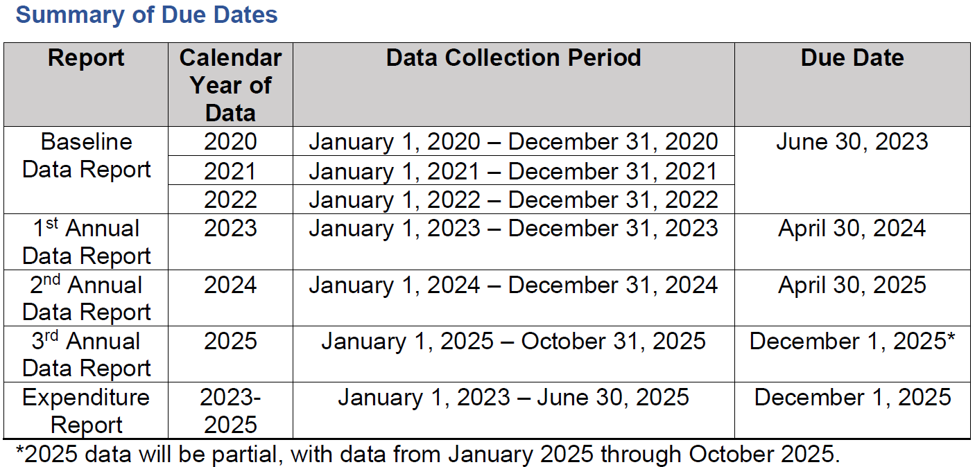
UFDT Report Deadlines
UFDT Data Reporting Guide Pages 2-3

Slide 9
UFDT Reporting Requirements and Reports Questions?

Slide 10
UFDT Baseline Data Report Demo
https://www.bscc.ca.gov/use-of-force-and-deescalation-training-pilot-program/
UFDT Data Reporting Guide Pages 4-5
Notes:
The Agency’s Definition of Use of Force: Each agency may have an agency specific definition of use of force that guides the agency’s work and the agency’s collection of use of force incident data.
We have the Agency’s Definition of Use of Force in each section because there may be changes that your agency made from year to year, so giving that option and providing that information will help provide more context to the data. In addition, in section 4, you may elaborate on the changes if necessary.

Slide 11
UFDT Baseline Data Report Questions?

Slide 12
UFDT Annual Data Report Demo
https://www.bscc.ca.gov/use-of-force-and-deescalation-training-pilot-program/
UFDT Data Reporting Guide Pages 6-11
Notes:
Training Name and Course Description example: Use of Force (PSP) This course provides updated legislative content of Penal Code Section 835a. This self-paced course is designed to improve students’ ability to observe, assess, and make appropriate real-time use of force decisions when required using body worn camera video. The course consists of practical, simulation-based, interactive training.

Slide 13
UFDT Annual Data Report Questions?

Slide 14
UFDT Expenditure Report
Only complete and submit with 3rd Annual Data Report
Demo
https://www.bscc.ca.gov/use-of-force-and-deescalation-training-pilot-program/
UFDT Data Reporting Guide Pages 11-12

Slide 15
Technical Assistance
Email questions or concerns to:
UFDTPilotProgram@bscc.ca.gov

